Slide 1

C‘t webdev | Cologne | November 19, 2025
React
Fullstack
Server
or
Client
?
NILS HARTMANN
first
and
https://nilshartmann.net

Slide 2


https://nilshartmann.net
NILS HARTMANN
nils@nilshartmann.net
Freelance Software Developer
Java, Spring, GraphQL, React, TypeScript
https://graphql.schule/video-kurs
https://reactbuch.de

Slide 3
C‘t webdev | Cologne | November 19, 2025
React
Fullstack
Server
What is that? 🙀
or
Client
?
NILS HARTMANN
first
and
https://nilshartmann.net

Slide 4
Server side rendering (SSR)
„Fullstack“ React
My definition
Client-first

Slide 5
Server side rendering (SSR)
„Fullstack“ React
My definition
An application contains UI/Rendering code on both server and client side
Client-first

Slide 6
Server side rendering (SSR)
„Fullstack“ React
My definition
An application contains UI/Rendering code on both server and client side
For both sides a framework is used
Client-first

Slide 7
Server side rendering (SSR)
„Fullstack“ React
My definition
An application contains UI/Rendering code on both server and client side
For both sides a framework is used
Framework contains solutions for rendering, routing, data fetching, ...
Client-first

Slide 8
Server side rendering (SSR)
„Fullstack“ React
My definition
An application contains UI/Rendering code on both server and client side
For both sides a framework is used
Framework contains solutions for rendering, routing, data fetching, ...
💡React it self provides low-level APIs for server-side features
But: you need a framework to make use of it
Client-first

Slide 9
Our
Candidates

Slide 10
Client-first
Client-first

Slide 11
Client-first
Client-first
https://tanstack.com/start
Currently RC
Vite Plug-in
Supports: serverside rendering (SSR), streaming, server functions
No React Server Components (yet)
TanStack Start

Slide 12
Client-first
Client-first
Idea:
Build a „traditional“ SPA with TanStack Router
Move to serverside by adding TanStack Start
(ofc you can start with Start from the beginning)
Only parts of your logic run on serverside
TanStack Start = Router + Server

Slide 13
Client-first
Background
https://tanstack.com/router
Alternative / replacement for React Router
Can be used for „traditional“ client-side SPAs
Vite Plug-in, file-based routing, exceptional TypeScript support
TanStack Router

Slide 14
Server-first
Server-first

Slide 15
Server-first
Server-first
https://nextjs.org
Currently Next.js 16, based on newest React 19.2
Support for all most all client and server React features
Including React Server Components (RSC) and Server Functions
Next.js

Slide 16
Server-first
Server-first
Idea
(Almost*) all of your app runs on serverside
Only (small*) parts run on the client
Aggressive caching and performance optimizations for fastest UI
Next.js
* My interpretation / opinion

Slide 17
Demo
Time

Slide 18
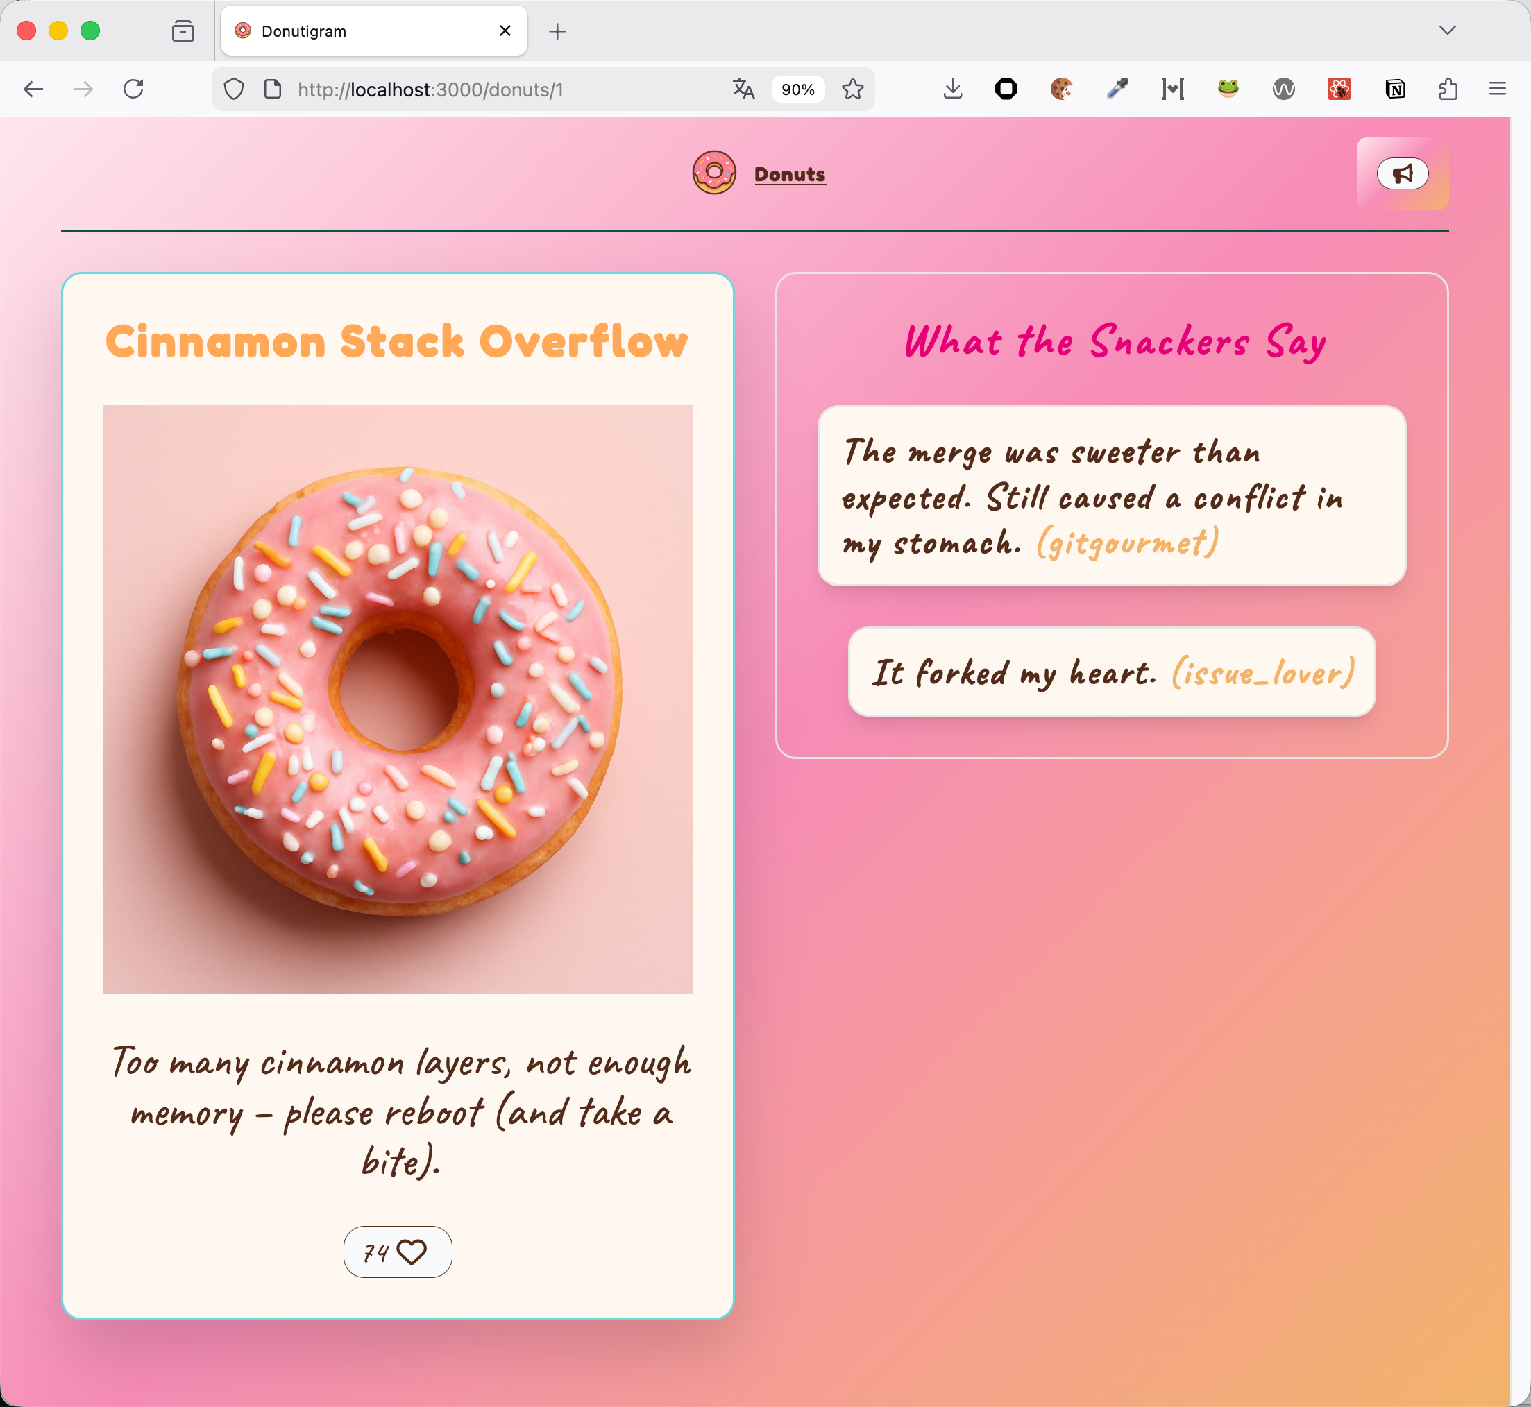
🔎 Our app...
http://localhost:3000

Slide 19
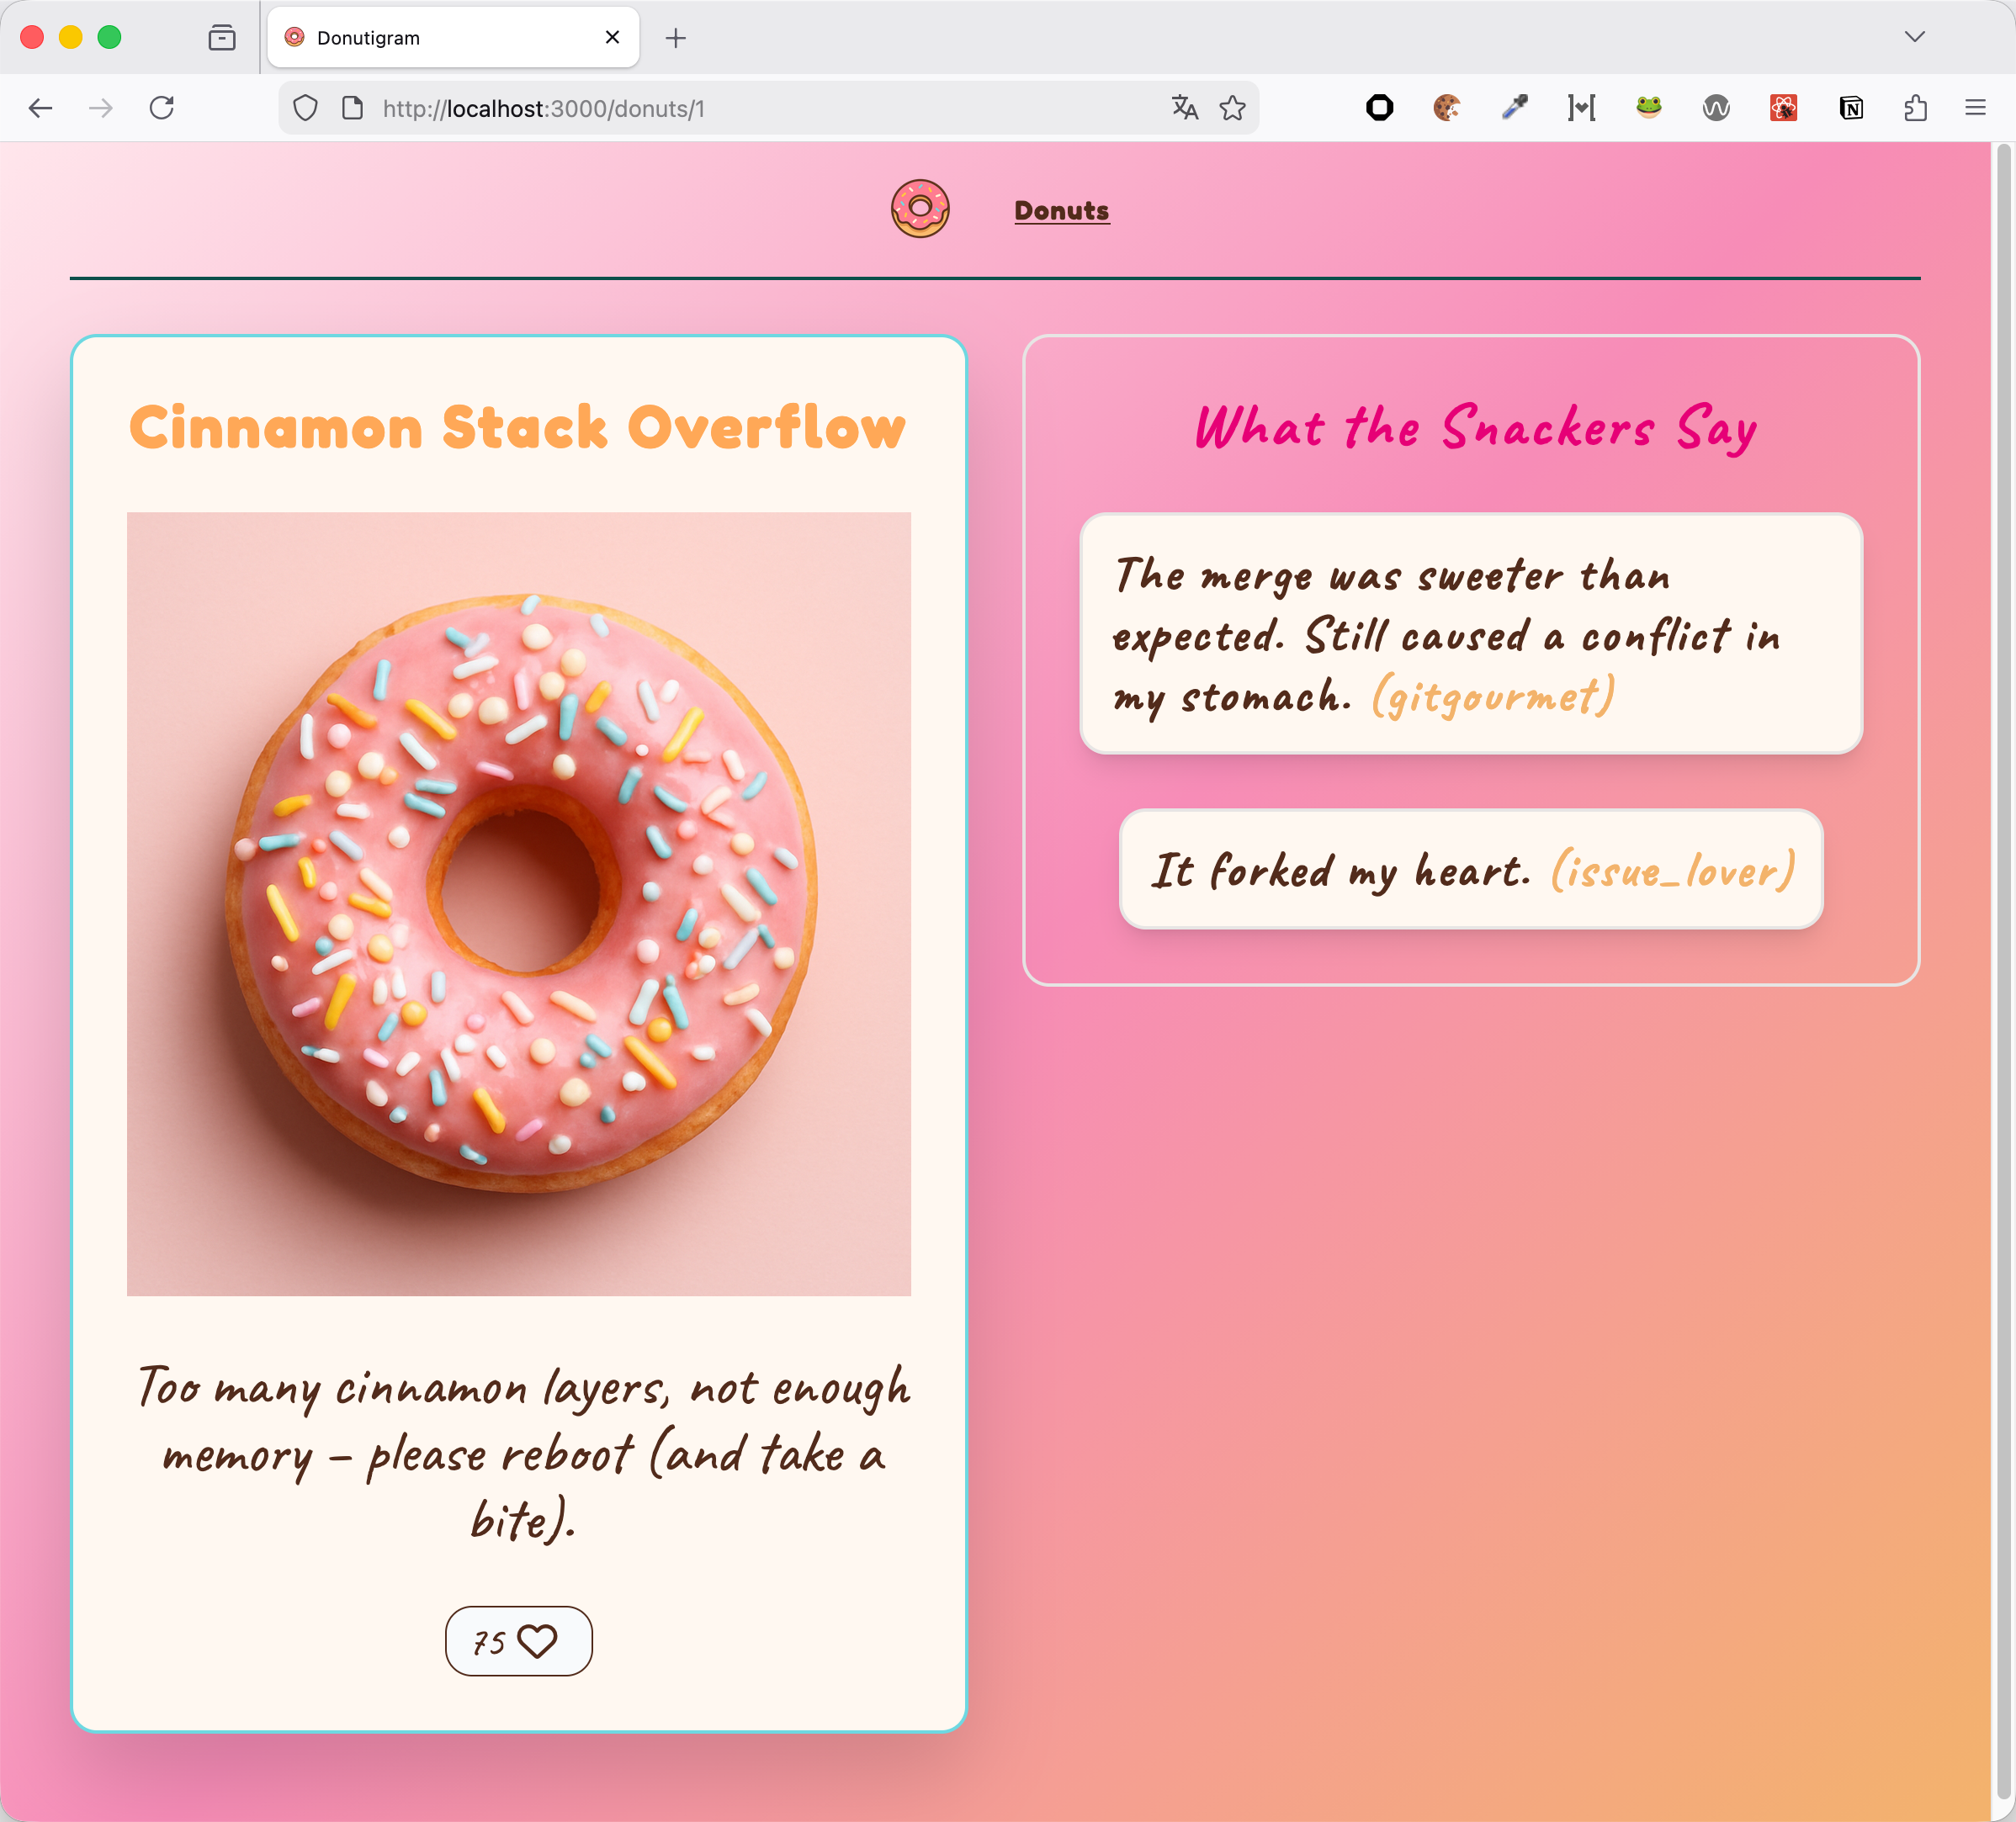
Demo 1
Dynamic Route
The „important“ features in action
Routing
Data Fetching
Serverside rendering
Data from two endpoints
Streaming

Slide 20
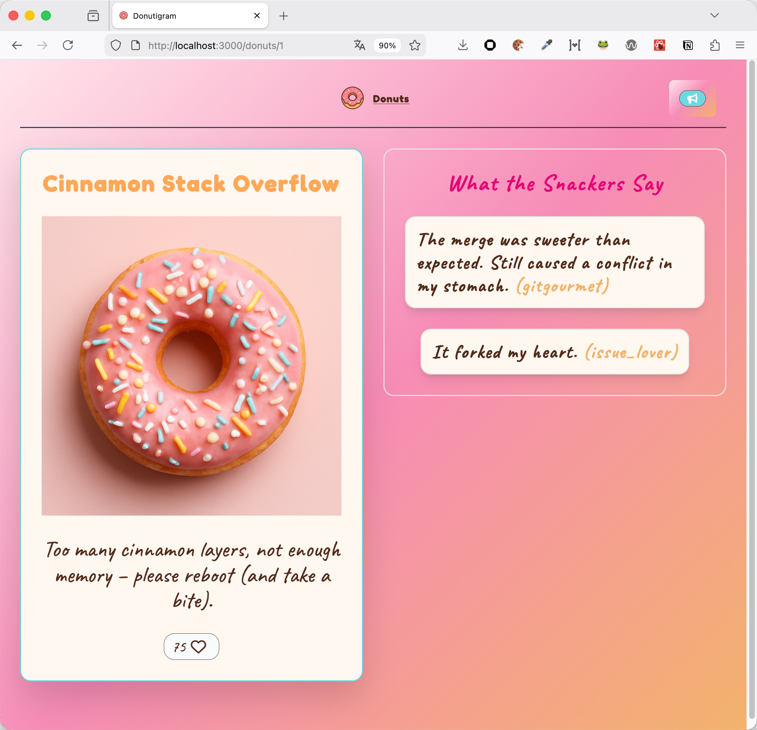
Demo 2
State
Interactivity
Client-side state

Slide 21
Demo 3
Server functions
aka
Server actions

Slide 22
Comparison
Side
by
Side

Slide 23
Server side rendering (SSR)
Server-side rendering (SSR)
TanStack Start
„Classic“ SSR
Only initial request is server-side rendered
HTML is returned
Complete JavaScript Code of the App is returned and hydrated
Client-first

Slide 24
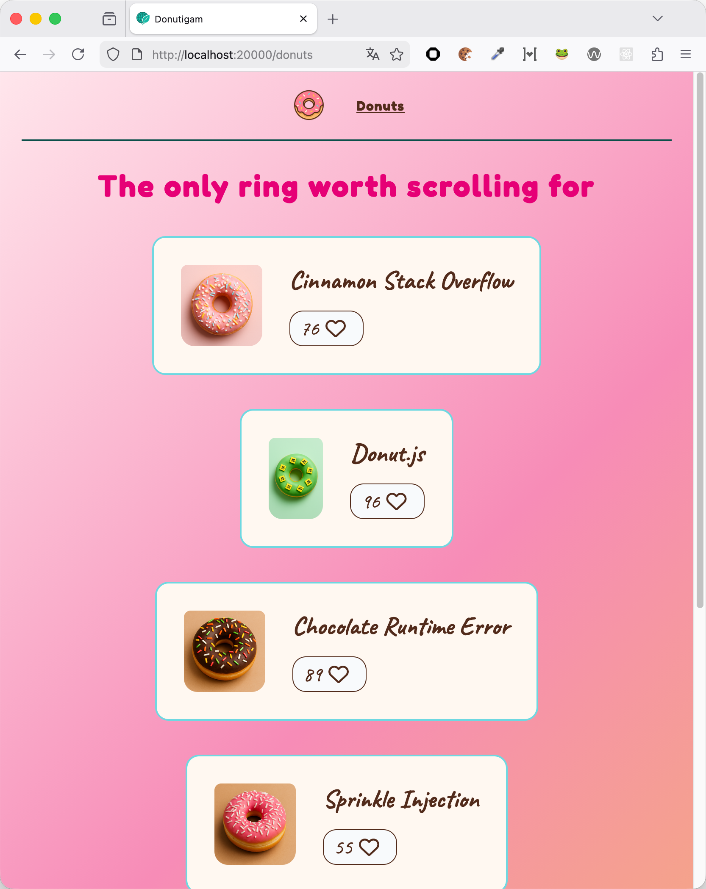
Server side rendering (SSR)
Server-side rendering (SSR)
Next.js
„Classic“ SSR plus React Server Components (RSC)
First request returns HTML
RSC Payload is returned on all request
Only Client Components are hydrated
Any navigation (route change) is server request!
State in Client Components survives
Server-first
React Server Component
Client Component

Slide 25
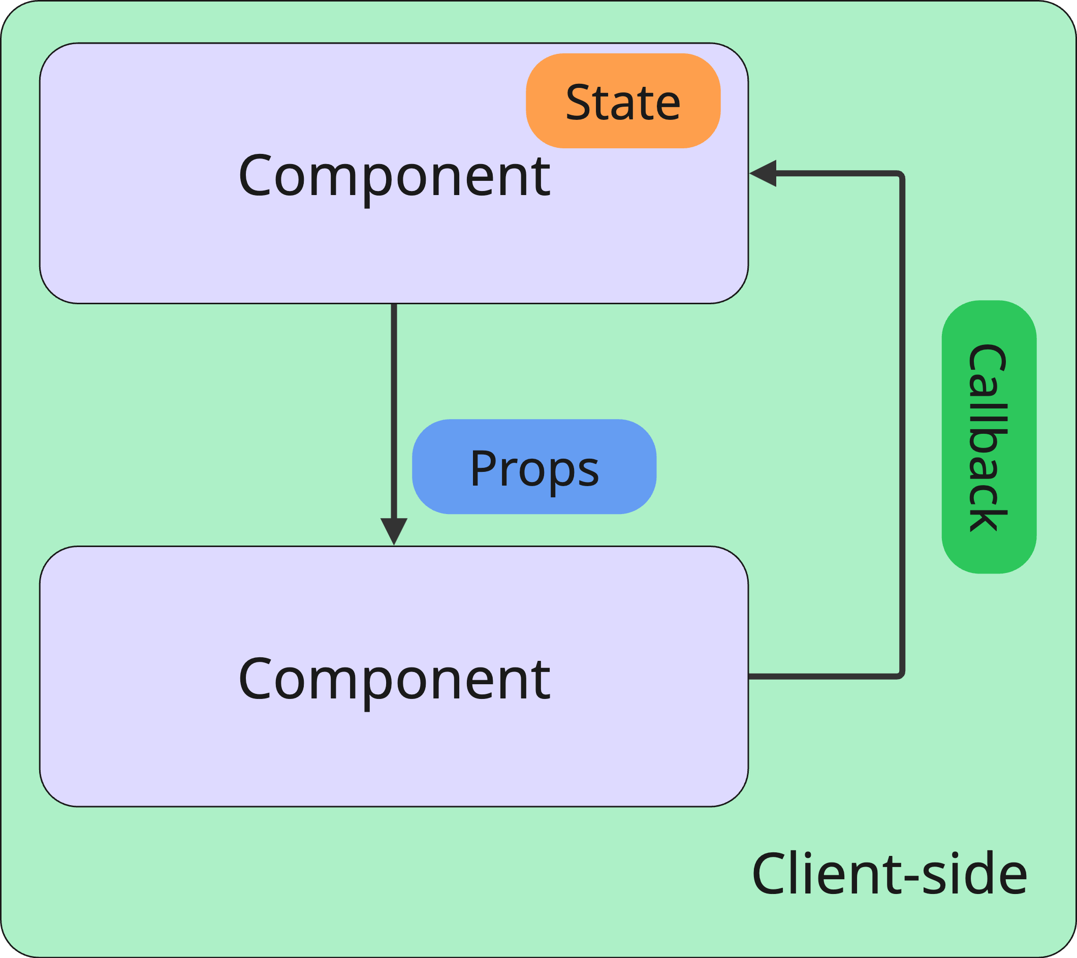
Server side rendering (SSR)
Architecture
TanStack Start
You data is available in the client
You code follows „traditional“ React architecture
Typical render cycle
Client-first

Slide 26
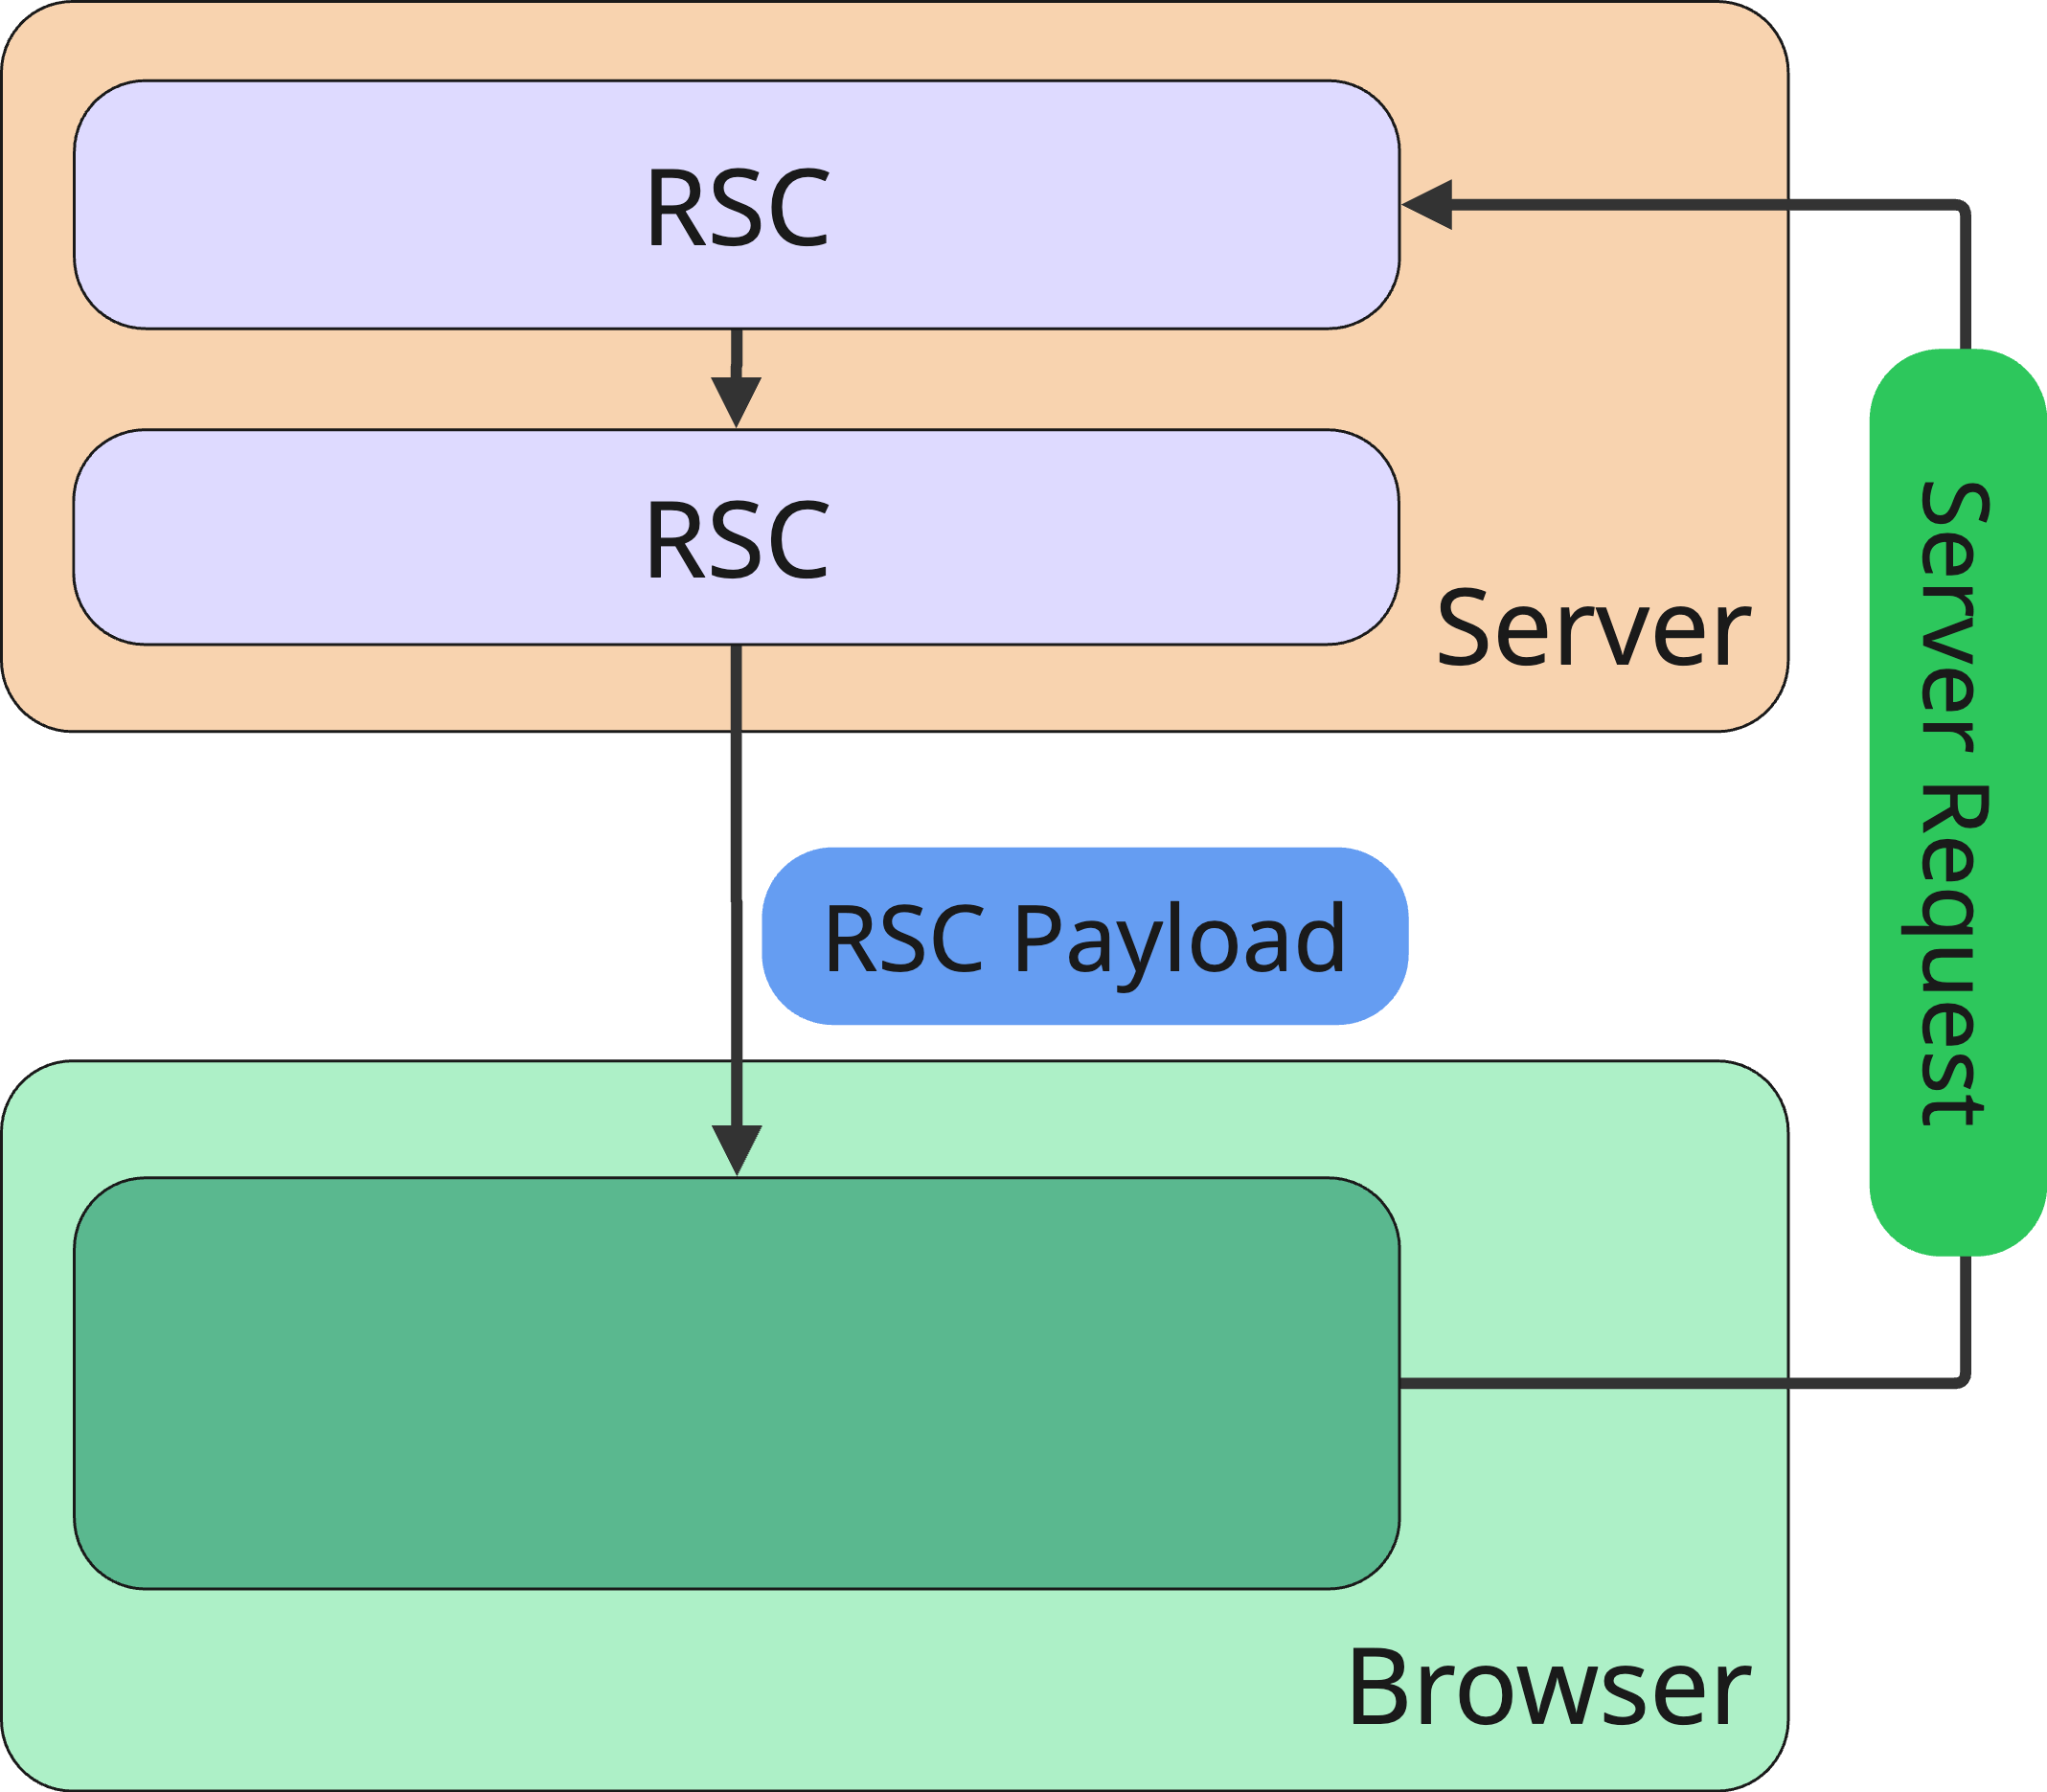
Server side rendering (SSR)
Architecture
Next.js
Typically you have „rendered UI“ on client
No data (exception: client components)
To re-render, server roundtrip might be neccessary
Example:
Re-ordering a list
Server-first

Slide 27
Server side rendering (SSR)
Global state
TanStack Start
Works with any global state solution, as state is only on the client
For populating global state during SSR, your library must support it
Client-first

Slide 28
Server side rendering (SSR)
Global state
Next.js
You can use global state for client components
Somehow complicated: we have server round trips on any navigation
Client-side global state can differ from server
Example:
On navigation on server side new data is read and rendered
Client-side global state doesn‘t know about that
UI is inconsistent
Server-first

Slide 29
Server side rendering (SSR)
Routing
TanStack Start
Based on TanStack Router (replacement for React Router)
Vite plug-in
Filebased routing
Highly typesafe for routes, params and search params
Client-first

Slide 30
Server side rendering (SSR)
Routing
Next.js
Built-in file-based Routing
Params and search params and are promises passed as props
Server-first

Slide 31
Server side rendering (SSR)
Data fetching
TanStack Start
Use library of your choice (typically: TanStack Query)
Data can be pre-loaded in loader functions of each Route
Support of Suspense and Streaming
Client-first

Slide 32
Server side rendering (SSR)
Data fetching
Next.js
Typically in async React Server Components
When using in Client Components, it‘s up to you
You can load data for Client Components in RSC and pass data as props
A few restrictions for properties apply (serializable!)
You can even pass promises from server to client
Server-first

Slide 33
Server side rendering (SSR)
Server functions
TanStack Start
Defines explicit API (function) for defining server functions
You can specify http method (post or get)
Handler for validating input arguments
Almost all argument types are supports
When calling your server function you need to pass a single argument
You can call your server function wherever you want
Client-first

Slide 34
Server side rendering (SSR)
Server functions
TanStack Start
Client-first
const likeAction = createServerFn({ method: "POST" })
.inputValidator((data) => { if (typeof data === "string") { return data; } throw new Error("Invalid data"); })
.handler(async ({ data: donutId }) => { const response = await ky.put(`...`) return DonutDto.parse(response); });
Server
function doLike(donutId: string) { return saveLikeAction({ data: donutId, }); }
Client

Slide 35
Server side rendering (SSR)
Server functions
Next.js
„Official“ React Server Function (aka Server Actions)
Server functions can be inlined in Server Components or files
Defined using a „use server“ directive
Only for write operations (do not call while rendering)
Server-first

Slide 36
Server side rendering (SSR)
Static Side Generation (SSG)
TanStack Start
Supported
Does not seem to be a first-class use case
For generation, your complete side is crawled
Client-first

Slide 37
Server side rendering (SSR)
Static Side Generation (SSG)
Next.js
Can be used to fully generate static pages in build
You can even partially generate pages
Aggressive (and complex...) caching
Server-first

Slide 38
Server side rendering (SSR)
Pre-rendering/pre-loading
TanStack Start
Loaders are executed before rendering
<Link /> components determines pre-loading behaviour
Default behaviour can also be set globally
Client-first

Slide 39
Server side rendering (SSR)
Pre-rendering/pre-loading
Next.js
Per-default enabled for all internal links
Is that a good choice?
To change behaviour you have to set the property on every <Link />-component
Server-first

Slide 40
What to choose?
Summary

Slide 41
Server side rendering (SSR)
Summary
Summary
First: Do you really need server-side React at all?

Slide 42
Server side rendering (SSR)
Summary
Summary
First: Do you really need server-side React at all?
Next.js:
Probably nearest to React ideas and APIs
Shines if you need aggressive caching, prerendering etc.
Can be tricky with traditional React patterns, like often changing global state

Slide 43
Server side rendering (SSR)
Summary
Summary
First: Do you really need server-side React at all?
Next.js:
Probably nearest to React ideas and APIs
Shines if you need aggressive caching, prerendering etc.
Can be tricky with traditional React patterns, like often changing global state
TanStack Start:
APIs are more explizit (createServerFn)
Concept easier (?) without RSC (not „two worlds“)
Suitable for interaktive apps that needs SSR (SEO etc.)

Slide 44


NILS HARTMANN
https://nilshartmann.net
Thanks a lot!
Code & Slides: https://react.schule/ctwebdev2025-fullstack
Questions and contact: nils@nilshartmann.net
My workshops (de): https://nilshartmann.net/workshops
will publish the source code later or tomorrow (please be patient)

